Slide 1


Crazy Data Science

Slide 2












Slide 3


Your host for this session!
Enrico van de Laar
Founder | Data & Advanced Analytics consultant @ Dataheroes
Microsoft Data Platform MVP
Author
Speaker
Blogger
Twitter: @evdlaar
Email: enrico@dataheroes.nl Web: http://www.enricovandelaar.com

Slide 4
Why “crazy” data science?
Complex problems, methods, techniques and solutions are easier to understand and learn by linking them to absurd use-cases

Slide 5
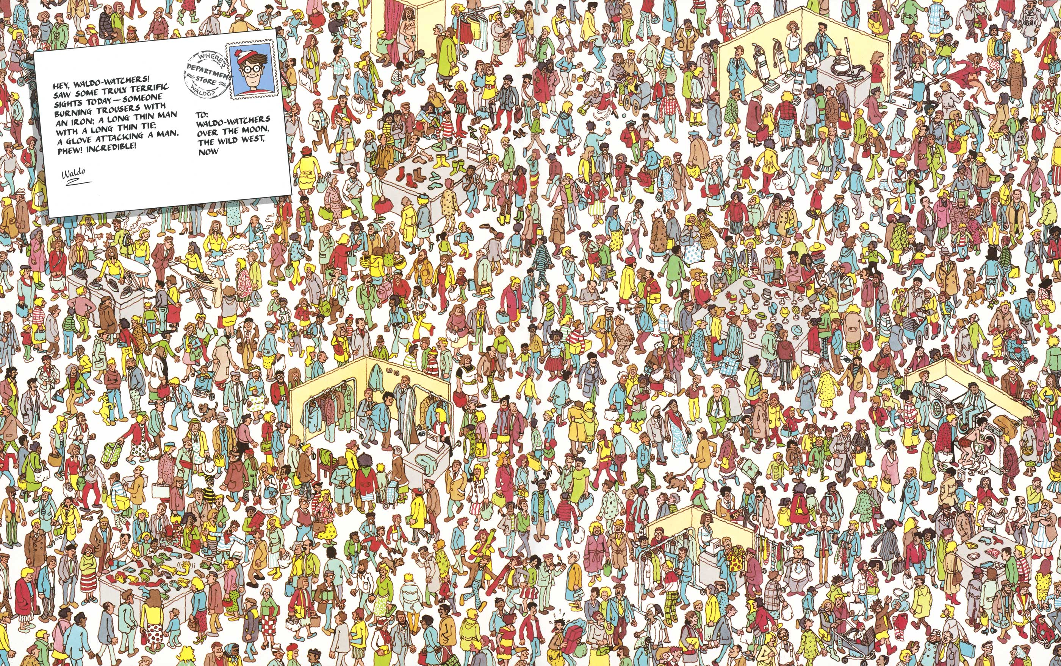

The plan:

Slide 6
Resources
Crazy Data Science Twitter: @CrzyDataScience
Crazy Data Science YouTube Channel: https://bit.ly/2FttGmW
Crazy Data Science GitHub https://github.com/CrzyDataScience
Twitter Enrico @evdlaar

Slide 7


Slide 8

Thank you!
Get a free trail at
https://www.dataprivacyguard.io/datascotland-trial-signup/

